Slide 1



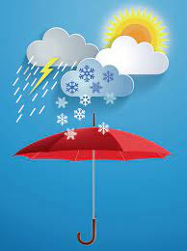








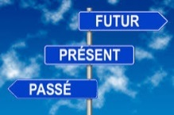

Year 9 French Learning Journey
Sir Roger Manwood’s school
Languages at SRMS have a strong emphasis on the applying of knowledge & skills to the real world and how languages work. The applications and implications of what we learn permeate throughout the course content.
Year 9
Understanding and Applying Language Skills
Year 10
Recognizing patterns- adjectives/nouns
Understanding and using the past
(perfect + imperfect)
Understanding and using the future
(near + simple)
Phonics- common French sounds
Describing & comparing cultures
Skimming and understanding longer texts
Preparing for everyday situations
Using higher level vocabulary & structures
Extending answers, orally and in writing
Understanding and using 3 time frames / 5 tenses
Weather forecast
Healthy / unhealthy lifestyles
Adverbs
Silent letters
Expressions with avoir
The imperative form
At the chemist’s and the doctor’s
Depuis + present tense
Booking a hotel room and reporting problems
YEAR
Health
10
A theme park visit
Giving & understanding advice
Regular & Reflexive verbs- present
Nasal sounds
Saying what and how long something has hurt
Letter strings
Asking & answering questions in the past
Weather in the past
The pronoun y
Body parts
Asking questions
Silent letters
How do you get on with people and why
Sights of Paris + at the tourist office
Jobs and careers
Genders/ agreement
Options and work experience
Book/film reviews
Adverbs
Internet and computing
Perfect tense- negative form
The perfect tense with avoir
Letter strings
Comparative and superlative form
Le Métro
Hotel description
YEAR
School & Jobs
Leisure
Yourself and family
Paris
9
Regular and irregular verbs in the simple future tense
Immediate future tense
Negatives
Letter strings
Theme parks
Description of school and the school day
Comparing past and present
Leisure activities
Irregular verbs: avoir & être
Adjectives
Letter “e”
The perfect tense with être
Using 3 time frames
The imperfect tense
Describe aspects of daily life
Yourself, family & pets
Present and perfect tense
Time expressions and opinions in the past
Future plans
Silent letters
Different sounds
Describe a
visit/weekend in the past
Vocabulary
Phonics
Grammar
ENGAGE • EXPLORE • EXCEL

